Slide 1


CHCCCS004 Diploma Community services
Assess co-existing needs
Session 1

Slide 2
Study tips
Be realistic and plan your workload.
You will not have to attend prescheduled training, but you will have to do regular learning. So if there is insufficient time in your personal schedule to do the work of the course, you will be frustrated and you may become stressed.
Keep reminding yourself of the reason you started the course.
Organize a study schedule.
Identify study times when you are fresh and attentive and stick to those times every week.
Think of the study times as ‘reserved time’.
If you miss too many study times, revise your schedule.

Slide 3

Elements covered to broaden your assessment capabilities
1: Prepare
2: Analyse needs
3: Determine service
4: Report
5: Evaluate

Slide 4
What you will learn about – Unit outcomes
Defining assessment
Setting up assessment
Observation & questioning
Asking questions
Obtaining information
Values, beliefs and assumptions
Best Practice
Assessing capacity and functioning
Identification of life stages (social, physical, psychological needs)
Strength-based assessment
Person- centred assessment
Develop a plan in consultation
Best Practice
Challenges of assessment
Suitable services for clients
Specialist services
Client rights, responsibilities, privacy, confidentiality
Communication techniques
Assessing multiple support needs
Tools for assessment
Use of tools for assessment

Slide 5
Who are our clients?
Think about who you might work with as a welfare and community worker in your role?
What area of Community services would you like to practice casework in ?
What do you think are some of the current and contemporary trends in society that have seen growth in case work demands?

Slide 6
Contemporary social work
“The social work profession promotes social change, problem solving in human relationships and the empowerment and liberation of people to enhance wellbeing.
Utilising theories of human behaviour and social systems, social work intervenes at the points where people interact with their environments.
Principles of human rights and social justice are fundamental to social work”
(AASW Code of Ethics 2010)

Slide 7

What is preparing for assessment of a client ?
You must prepare for any assessment with a client
The process Must take into account a clients needs – emotional, physical, emotional, social, cognitive, cultural.
You must develop rapport to be able to identify clients needs
You need to negotiate a time and place for assessment
You need to inform client of policies – confidentiality/privacy
Clients must give their written consent for the assessment
You may need to include interpreters/interpreting services to ensure clients understanding

Slide 8
We must recognise the full range of needs and refer people to relevant organisations wherever these needs are outside your own service capacity, using Service Coordination Tool Templates to assist you.
Service coordination framework
Setting the scene
Initial contact
Care planning
Initial needs identification
Assessment
*Consent
*Referral
*Feedback
*Service delivery
*Exiting
Initial Contact
Needs Identified
Assessment
Care planning

Slide 9
Person centred assessment principles
Clients are treated with respect and dignity.
Clients receive a timely response: the right assessment, in the right place, at the right time.
Assessment approach is empowering and builds relationships over time.
Approach is client driven, culturally sensitive, flexible and is solutions-based.
Communication during the assessment process is in the client’s preferred language, utilising a language service or bilingual assessment staff.
Clients are well informed of their role and rights in the assessment process, most importantly, their right to determine their own needs and be actively involved in decision making.
Respect for client’s right to privacy should be maintained by all staff involved in collecting and storing client information.
Where there is a family member or carer present, assessment focuses on the care relationship, rather than the individual in isolation

Slide 10
Initial Contact with a client
Initial contact is the person’s first contact with your organisation or the service system as a whole.
Initial needs identification is a broad screening process to uncover underlying and presenting issues.
Information from the initial needs identification will inform the way that the assessment process is likely to proceed.
Initial needs identification may start with the intake worker
Establish what other assessments have already occurred?
Intake workers need to seek as much information as possible about existing supports and assessment, or planning processes provided by other organisations.
Reassure the person that providing this information will not mean they will be automatically refused access to services. Access is based on priority of access guidelines and current demand for services.
Ask the person about other services they have spoken to or used in the last 12 months.
Ask the person for their consent to speak to other providers and family members or carers.
Ask the person for their consent to service.

Slide 11
Skills & Techniques
Knowledge of a person’s supports means that existing processes can be built on. Agencies can work together with the person and their family or other carers to get the best outcomes. Building trust between all the parties involved is an important first step.
During initial contact and initial needs identification, the person will seek information and gain an impression about the organisation. Tone of voice, style, approach, language, time taken to explain the process, listening to concerns and offering choices will inform their perception.
From an Aboriginal and CALD perspective, the initial contact and initial needs identification experience is critical to building trust and rapport and hence, the future success of assessment and service provision.
Together devise a plan for the client.
“We may be able to arrange a support person to be present for you, such as a person from an Aboriginal organisation or CALD organisation, with your consent” - An interpreter can be arranged for you, we will ask you some questions to work out what you would like to change or achieve, this meeting is confidential , I’d like to hear your expectations of the service”.

Slide 12
Consider the following questions prior to assessment
Is an assessment required?
What is the reason for assessment ?
What needs and issues are we assessing?
Which type of assessment will best address these needs and issues?
Will the assessment tool be relevant to the person’s circumstances?
What is my role in the assessment process?
Does the person require referral to a more qualified or specialist agency?
How will the assessment be conducted?
Where should you conduct the assessment?
What resources will you need to conduct the assessment?

Slide 13
Paving the way to an outreach ‘home' visit Building rapport.
Before the home visit, prepare by:
reviewing intake information
contacting the person to gain consent to speak with relevant others (such as family, carers, friends, GP, other service providers)
reading case notes, referrals, assessments or care plans from other organisations
asking if the person identifies as Aboriginal, and if so, offering to arrange for a Aboriginal worker to be present, to ensure the process is culturally appropriate
asking if the person has a CALD background, and if so, if they would like a worker from a relevant organisation, or informal advocate, family member or carer, neighbour or friend, to be present.
checking the person’s English language proficiency for assessment purposes
Is an interpreter (in person or by telephone) needed for effective communication
enquiring if other family members or carers will be present and the person is comfortable with that arrangement
updating their knowledge about health concerns.
asking a younger person with a disability if they use assisted communication techniques or sign language.
Before entering a person’s home:
consider the person’s willingness for you to visit their home,
be aware of cultural practices you will need to observe consider what is important to them
consider their thoughts about the assessment process, their main concerns and the desired outcome
check OHS matters relevant to the assessment visit, such as known risk factors.

Slide 14
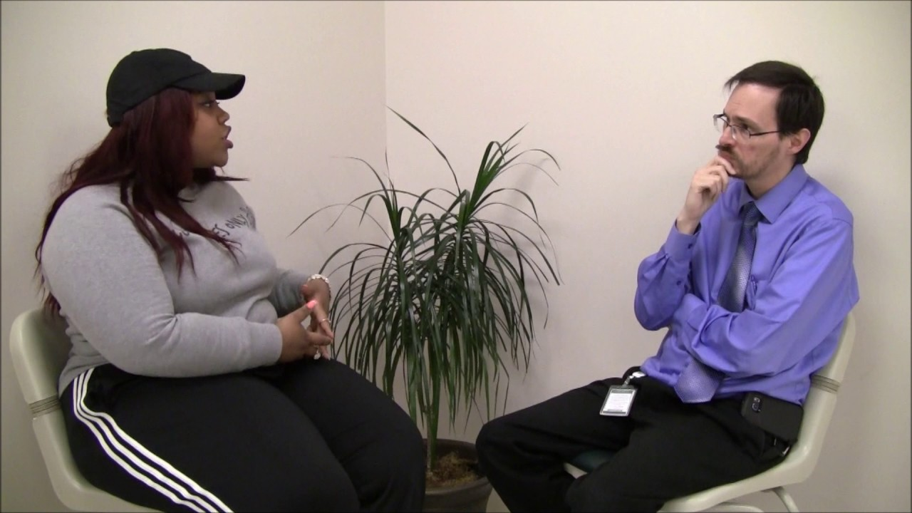
Intake & Assessment role play
YouTube (8:50)
https://www.youtube.com/watch?v=OPCYGqzf7Us

Slide 15

Practice Scenario
Yvonne is 84. She lives in a retirement village with her husband and carer Bill. Yvonne was diagnosed with Alzheimer’s 3 years ago and has experienced an increased level of cognitive decline recently. She now requires reminders about personal care and cannot be left alone. Yvonne recently broke her foot and is unable to walk as a result. When you meet with Yvonne to make an assessment of her support needs you notice she is wincing in her wheelchair. Yvonne softly moans and seems to be in a lot of pain. You also notice her husband/carer Bill seems quite impatient with Yvonne and you over hear him telling her to “shut up and stop complaining… you never stop whining”
Break out room groups discussion:
What might you need to consider prior to undertaking an assessment with Yvonne? Specifically think about these areas:
• Safety of Yvonne and Bill (including emotional safety)
• Gathering information
• The capacity of Yvonne to participate in the assessment

Slide 16
Question 1
Think about ……
Questions you could ask Yvonne to see what her support needs and priorities are.
What have you observed so far with Yvonne and Bill to inform the types of questions you might ask.
Reflect and consider two questions you might ask Yvonne at the beginning of an assessment
Consider how you might be building rapport and understanding between yourself and Yvonne.
Question 2

